Slide 1

RESPONSIVE
2 Corinthians
Dr. Rick Griffith • Crossroads International Church Singapore
BibleStudyDownloads.org

Slide 2

Hi!
Notes:
One of our cruelest responses to others is apathy. Once I knew someone who simply ignored me. He acted as if I did not exist. When I talked, he pretended not to hear. When I walked toward him in a hallway as he walked toward me, he wouldn’t greet me. When I was in the same room as him, he watched me in the corner of his eye to assure that he would sit on the other side of the room. I sat down with him and his wife some years ago to talk about it and see what I had contributed to this. He listed many vain imaginations of things I had done to spy on him, so he said that he was just trying to guard his privacy. The amazing thing about this is that I am the one responsible for sticking my neck out to help him find his calling in life.

Slide 3

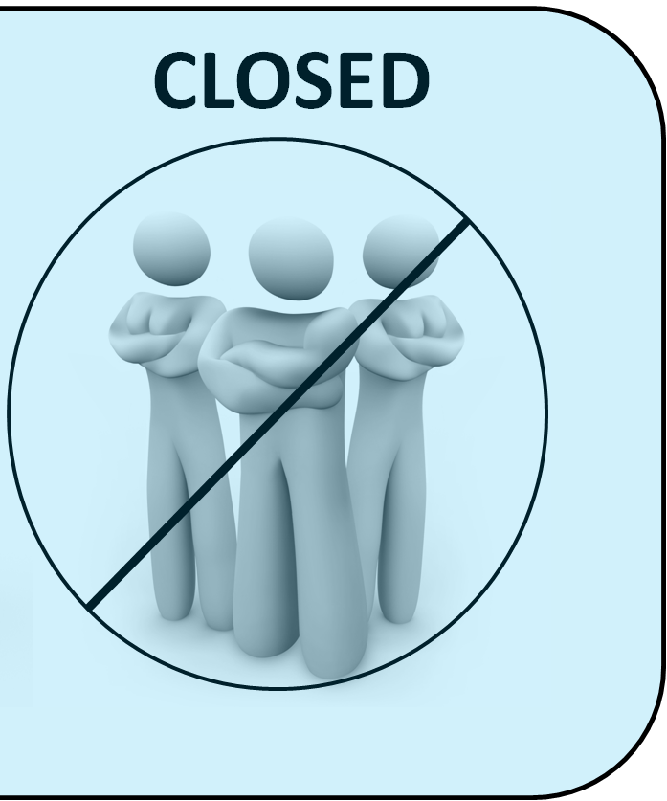
OPEN
CLOSED
Notes:
Maybe you can relate to my experience. You are open to people, but they are closed to you. One of our cruellest responses to others is apathy—or simply ignoring others—and you have seen this first hand.
Maybe your family background is far from ideal. Your father—or mother—neglected you growing up.
I find that here in Singapore many people struggle with apathy towards them at work. A worldwide survey was done some years back where people were asked, “Does your work energize you?” The USA had the highest score at 40%. The lowest country in the world was Singapore—only 2% said that their work energized them. When someone just looks at you like a robot to get work out of you, it is deflating.

Slide 4

God is not apathetic about you.
Notes:
What a wonderful thing to see that God is not apathetic about you! Hardly! Most of us are quite informed what God has done for us. Are we apathetic towards him in response?
God has given us people who care about us—do we appreciate them?
God has given us more resources than we need—do we share them with others?
God rescued us from the pain of sin—do we thank him for being free from that slavery?

Slide 5

How can you be responsive to God’s heart for you?
Notes:
How can you be responsive to God’s heart for you? Instead of apathy, what is the right way to respond to the Lord for all he has done to save you, provide for you, purify you, restore you?

Slide 6
Background to
2 Corinthians
Notes:
Paul reached out to a church that was feeling conflicted and apathetic towards him—even though he started the church!
Imagine investing yourself into someone substantially—you help him or her get a job, you train the person with life skills that lead to success, or you even raise the person as your son or daughter. Despite all this, then that person turns against you! How would you feel? Certainly, this would hurt deeply.

Slide 7
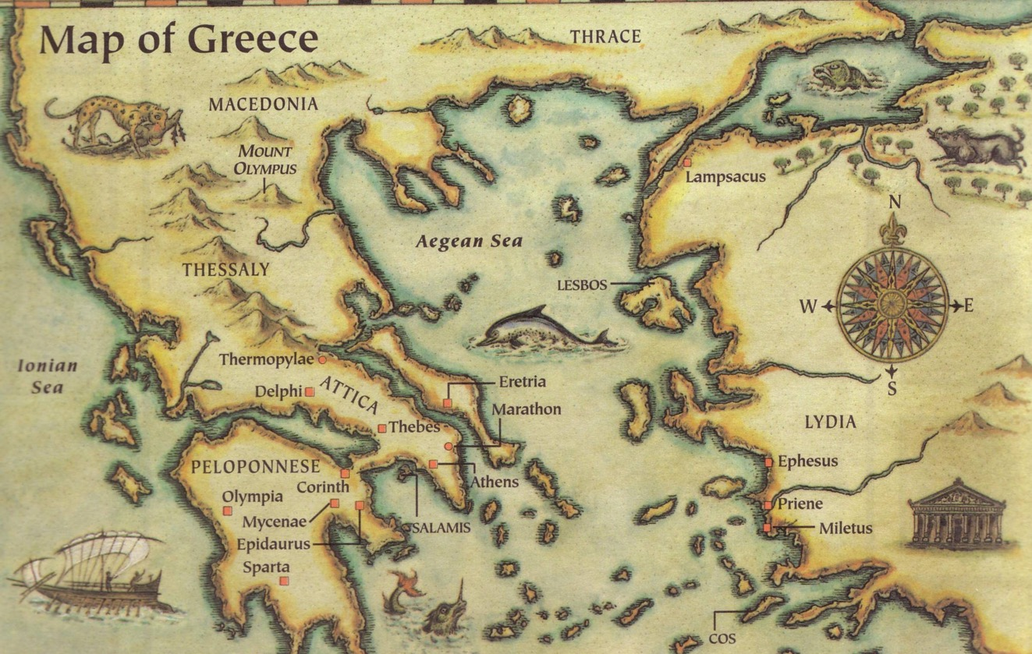
2 Corinthians was written in AD 56
Thessalonica
Berea
Athens
Corinth

Slide 8
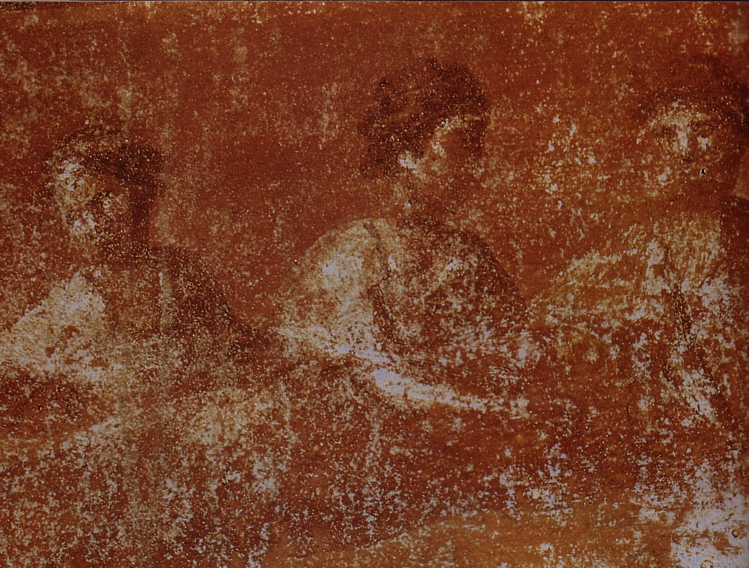
What was the early church really like?
Divorce (7)
Gifts (12-14)
1 Corinthians
Idolatry (8-10)
Incest (5)

Slide 9
NT Overview (Missionary Key Words)
38
124
39-41
"To the remotest part of the earth" (Acts 1:8)
Acts 9 13 14 15 16 18 21 27 28
Apr 48-
Sep 49
1
Galatia
Apr 50-
Sep 52
2
Aegean
Spr 53-
May 57
3
Asia
Feb 60-
Mar 62
1
Rome
Spr 62-
Fall 67
4
Spain
Aut 67-
Spr 68
2
Rome
Summer 35-
37
Damascus
Antioch
May 57-
Aug 59
Trials
Fall 49
The
Council
Spring 68
Expansion of Church
35 48 49 50 52 53 57 60 62 67 68 95
Matt
Kingdom
Luke
Sov 1
Acts
Sov 2
Mark
Disciple
John
Believe
Gal
Justify
1 Thess
Rapture
1 Cor
Sanctify
2 Thess
Tribulation
2 Cor
Apostle
Gospels & Acts
Pauline Epistles
1234
Journeys
Rome
Imprisonments
Pauline Missionary & Key Words

Slide 10

Be Different
1 Corinthians
Dr. Rick Griffith • Crossroads International Church Singapore
BibleStudyDownloads.org

Slide 11
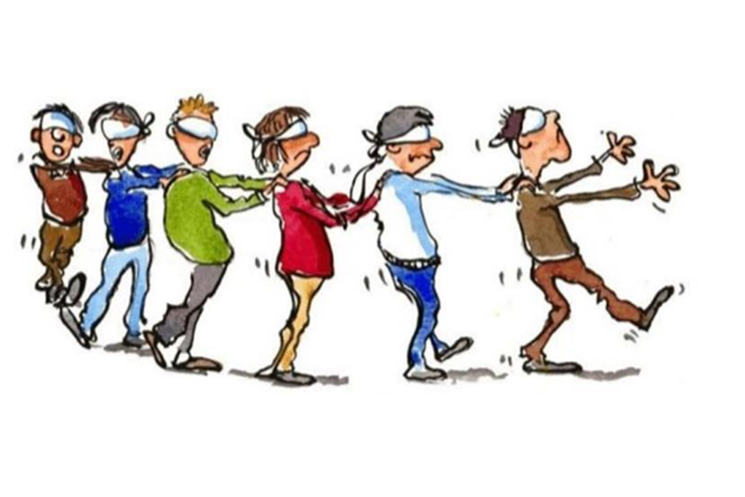
Herd Mentality
Notes:
We all are too keenly aware that there is a herd mentality in our world. It seems that the blind keeps leading the blind—insisting that we slavishly follow.
This week the governor of Virginia publicly argued for infanticide—and millions supported him!
Then pictures arouse of his racism while in medical school—so now politicians of his own party are calling for his resignation!
Since when is prejudice worse than killing babies right after birth?

Slide 12

Be Different
Notes:
In a world where right is considered wrong and wrong is deemed right, God has called believers to be different.

Slide 13

How should we be different from unbelievers?
Notes:
What are some of the ways that God wants your life to escape the herd mentality?
How does Jesus desire you to rise above the fray?

Slide 14

How should we…
BE
UNITED
(1–4)
BE
MORAL
(5–6)
BE
DIFFERENT
BE
SELFLESS
(7–16)
1 Corinthians
…from unbelievers?

Slide 15

Main Idea
Be different by being united, moral and selfless
1 Corinthians
Notes:
Said differently, do not divide the church, do not be immoral, and do not act only for your own benefit (restatement).

Slide 16

Sanctified = “Set apart by God as His possession”
Do you live like this?

Slide 17
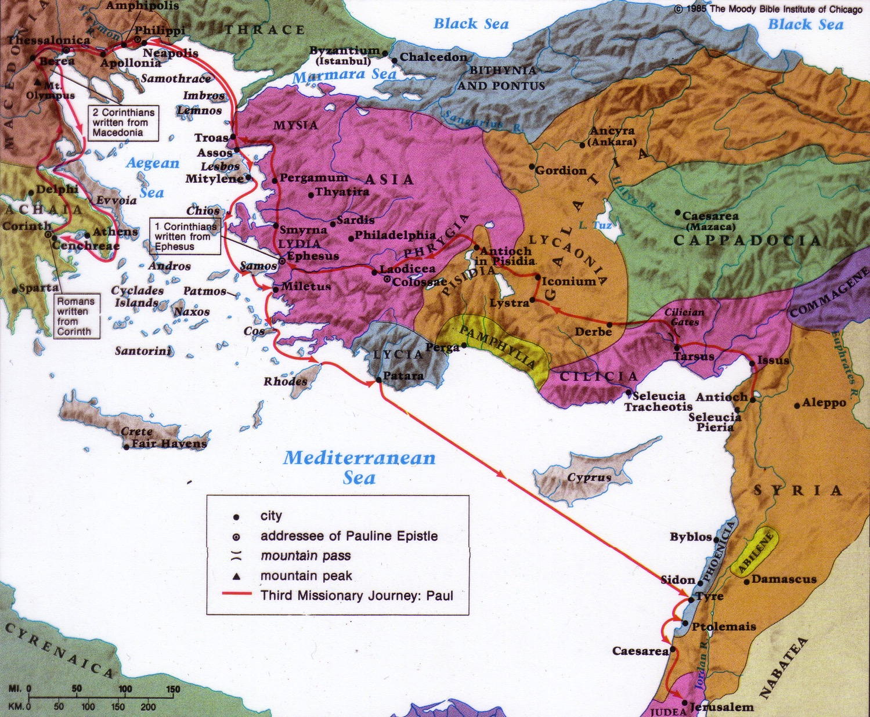
Review of 1 Corinthians
157
Date
1 Corinthians was written in May AD 56 (1 Cor. 16:5-8).
2 Corinthians was written less than a year after 1 Corinthians (2 Cor. 8:10; 9:2).
2 Corinthians followed later that year in fall AD 56.
Destination:
Corinth
Origin:
Ephesus
Origin/Recipients
Paul addressed the church at Corinth from the city of Ephesus across the Aegean Sea
Notes:
Occasion: Paul's planting the Corinthian church on his second missionary journey took about eighteen months from March AD 51-September AD 52 (1 Cor 3:6, 10; 4:15; Acts 18:1-17). Nearly four years later while in Ephesus on his third missionary journey he received disturbing reports from Chloe’s household about divisions in the church (1 Cor 1:10) and a letter from the church carried by three men (1 Cor 16:17) that requested Paul's opinion on certain issues (1 Cor 7:1; 8:1; 12:1; 15:1; 16:1). He answered the problem of divisions and gave the much-needed response to the church's questions in the letter of 1 Corinthians (he had already written a letter before this; cf. 1 Cor 5:9).

Slide 18
2 Corinthians Context
Origin:
Macedonia
163
Origin/Recipients
Paul addressed this second letter to the church at Corinth from the province of Macedonia north of Corinth.
Destination:
Corinth
Date
2 Corinthians was written less than a year after 1 Corinthians (2 Cor. 8:10; 9:2).
1 Corinthians was written in AD May 56. The letter of 2 Corinthians followed later that year in fall AD 56.
Notes:
However, within a year of Paul's writing 1 Corinthians, false teachers infiltrated the church (2 Cor 11:20) and stirred up the people against him by accusing him of being proud (2 Cor 10:1), fickle (2 Cor 1:16f.), unimpressive in appearance and speech (2 Cor 10:10), dishonest (2 Cor 8:16), and unqualified to be an apostle (2 Cor 11:23; 12:6-7). Paul saw this threat as valid reason to visit the church personally, and he refers to this second visit as a “painful visit” (2 Cor 2:1; 12:14; 13:1). He anticipates this visit in 1 Corinthians 16:5-9.
• After leaving the church this second time, Paul wrote a sorrowful letter (his third letter to the church) to urge the church to discipline the leader of the opposition (2 Cor 2:1-11; 7:8f.). Titus delivered the letter then met Paul in Macedonia with the good news that most of the Corinthians had repented of rebelling against Paul's apostolic authority (2 Cor 7:6-7). Nevertheless, Paul still felt it necessary to write the letter of 2 Corinthians to defend himself against the minority opposition (2 Cor 10–13). So, Titus turned right around and headed back to Corinth to deliver 2 Corinthians, accompanied by two other brothers (2 Cor 8:16-24). Later Paul made a third visit to the church, anticipated in 2 Corinthians 13:1; Acts 19:21 and recorded in Acts 20:2-3.

Slide 19
How can you be responsive to God’s heart for you?
3 ways
Notes:
Basically, 2 Corinthians addresses how the church can respond to God. It answers the same question for us: How can you be responsive to God’s heart for you? Instead of apathy, what is the right way to respond to the Lord for all he has done to save you, provide for you, purify you, restore you?

Slide 20

Open your heart to…
your leaders
(1–7)
2 Corinthians
Notes:
Encourage those who lead you.

Slide 21
Corinth should open their hearts to Paul since God cared for them through him
(2 Cor 1–7).

Slide 22
Slides on
2 Corinthians 1
Notes:
His postponed visit when they doubted his care actually prevented Paul from overly rebuking them for not disciplining their leader who opposed Paul (1:12-24).

Slide 23
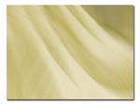
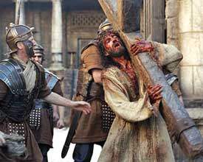
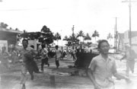
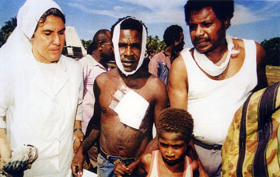
2 Cor. 1:1-11
Suffering
2 Cor. 1:1-11

Slide 24
Slides on
2 Corinthians 2
Notes:
Their discipline of this leader should make Paul’s next visit a positive one so that Satan would not drive a wedge between Paul, this leader, and the church (2:1-11).
Instead of returning, Paul’s sending Titus will remind them to spread the sweet aroma of Christ to believers and warn unbelievers of their impending peril (2:12-17).

Slide 25

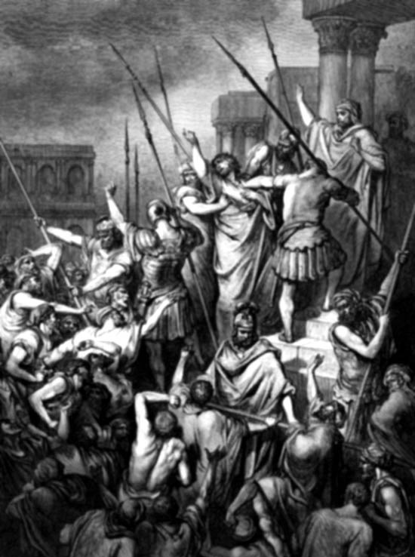
SUFFERING
SUFFERING
Paul's Suffering
Paul's Attitude Towards Suffering
Christ's Experience
Comfort Through Suffering
How do we face suffering?

Slide 26
Slides on
2 Corinthians 3
Notes:
Paul’s new covenant ministry blessed Corinth—not the false teachers (3:1–6:10).

Slide 27
Contrasting the Covenants (2 Cor. 3–4)
166c
Old Covenant | New Covenant
initiated by Moses (3:8) | initiated by Christ (3:4)
of the letter (3:6a) | of the Spirit (3:6a, 18b)
kills (3:6b, 7a) | gives life (3:6b)
engraved on stone (3:3b, 7a) | engraved on hearts (3:3b; Jer. 31:33)
glorious (3:7a) | more glorious (3:8, 10)
glory faded (3:7b, 11a, 13b) | glory ever-increases (3:11b, 18)
condemns men (3:9a) | brings righteousness (3:9b)
deception (3:13) | boldness (3:12)
veiled face of Moses (3:13b) | unveiled faces (3:13a, 18a)
veiled minds (3:14a) | unveiled minds (3:14b; 4:3-6)
veiled hearts (3:15) | unveiled hearts (3:16)
dullness (3:14a) | freedom (3:17)
Moses reflected God's glory | all believers reflect Son's glory (3:17)
non-transforming (3:7) | transforming (3:18)
lack of zeal (3:13) | confidence, steadfastness (3:4-5; 4:1)
deception (3:13) | sincerity (4:2)
Notes:
His ministry is even greater than Moses's since the glory of the new covenant is greater than that of the Mosaic covenant (2 Cor 3).

Slide 28
Slides on
2 Corinthians 4
Notes:
Paul never gives up during suffering because God's power helps him to minister for their benefit (4:1-15).

Slide 29
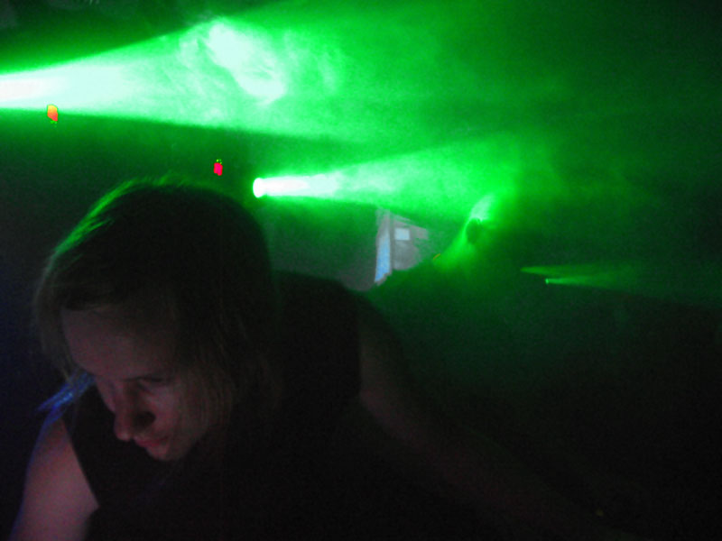
Was Paul discouraged?

Slide 30
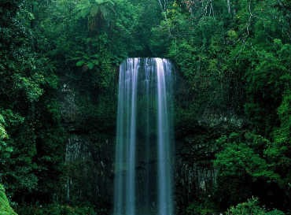
"Therefore we do not lose heart. Though outwardly we are wasting away, yet inwardly we are being renewed day by day"
(2 Cor. 4:16)

Slide 31
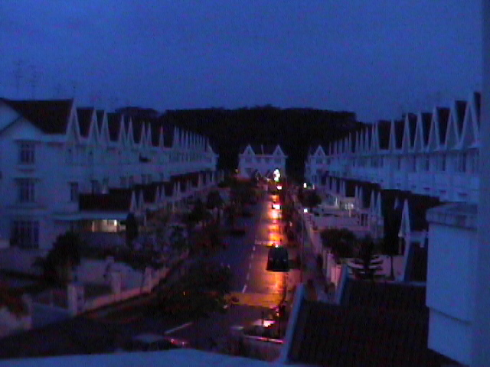
I. View your troubles as trivial compared to your rewards (4:17)

Slide 32
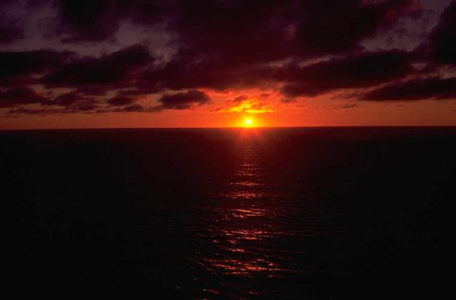
"For our light and momentary troubles are achieving for us an eternal glory that far outweighs them all" (4:17)

Slide 33
II. Focus on invisible, eternal realities (4:18)

Slide 34
See the invisible!
"So we fix our eyes
not on what is seen,
but on what is unseen.
For what is seen is temporary,
but what is unseen is eternal"
(2 Corinthians 4:18)

Slide 35
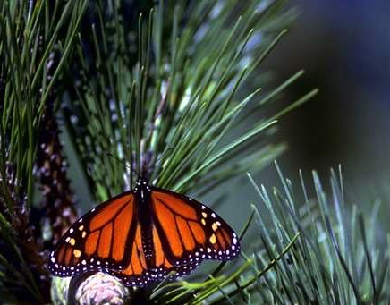
What is eternal?
God
God's Word
Souls of People

Slide 36
Slides on
2 Corinthians 5
Notes:
Paul retains courage in suffering because his motivation comes from an eternal view and a love that compels him in his ministry of reconciliation (4:16–6:2).

Slide 37
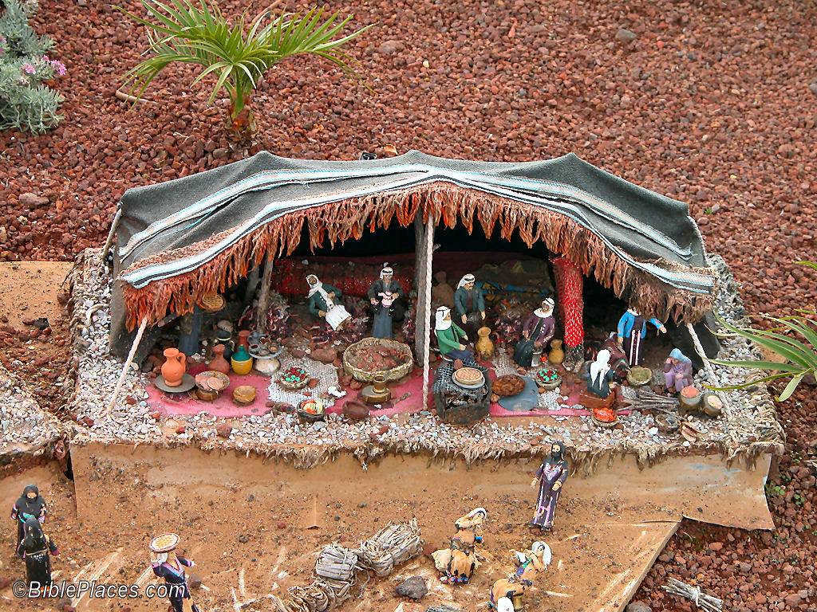
We will put away "this present tent"
(2 Cor. 5:1)

Slide 38
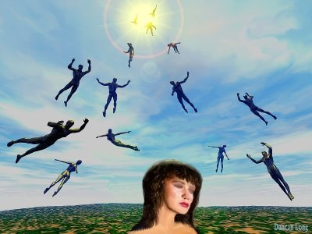
New bodies

Slide 39
The Judgment Seat of Christ
Is this a judgment to determine salvation?
Or is it to reward believers?

Slide 40
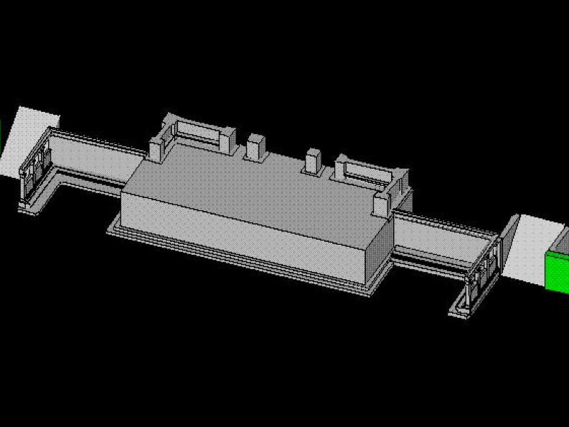
Bema Close-up
“So we make it our goal to please him, whether we are at home in the body or away from it. ¹⁰For we must all appear before the judgment seat [bema] of Christ, that each one may receive what is due him for the things done while in the body, whether good or bad” (2 Cor. 5:9-10 NIV).
Notes:
40
http://corinth.sas.upenn.edu/schola.html

Slide 41
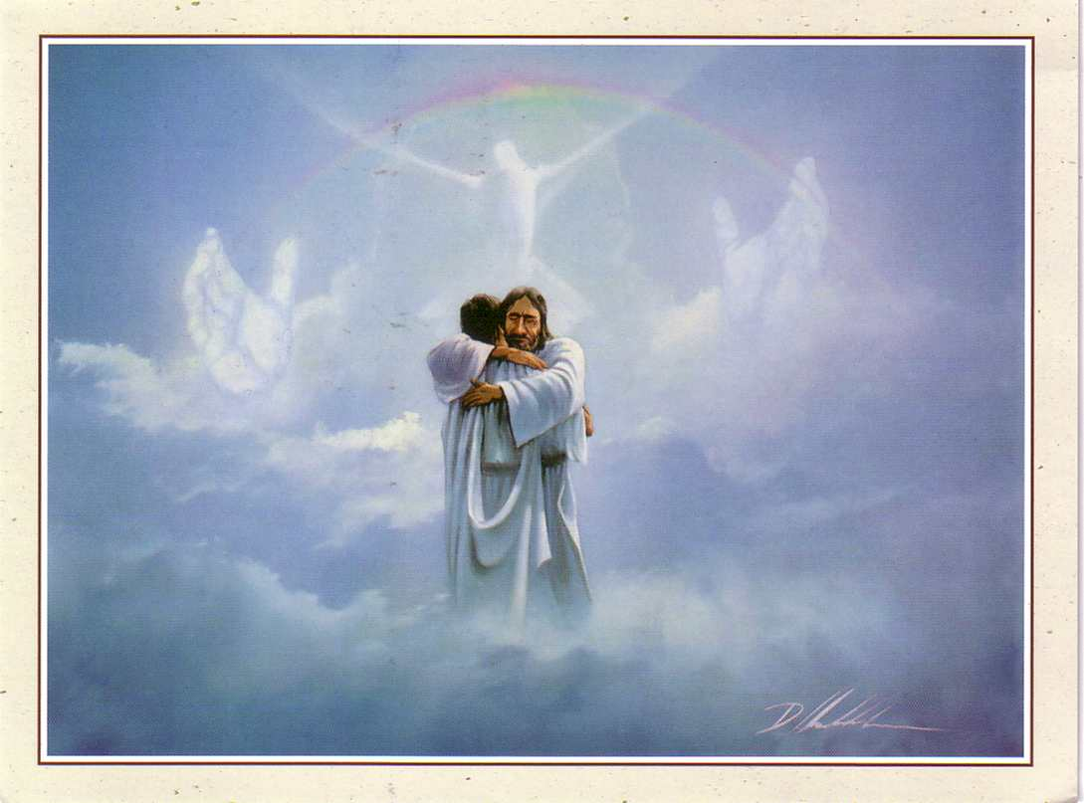
The Bema is a Reward Seat
76

Slide 42


2 CORINTHIANS 5:17
Therefore, if anyone is in Christ
he is a new creation.
The old has passed away;
Behold, the new has come.

Slide 43
Slides on
2 Corinthians 6
Notes:
Paul marks of a genuine ministry in his suffering does not discredit his ministry through offending others by requiring a comfortable lifestyle (6:3-10).

Slide 44

"I am asking you to respond as if you were my own children. Open your hearts to us!"
(2 Cor 6:13 NLT).

Slide 45

What does 2 Cor. 6:14-7:1 mean?
"
136
"Don't team up with those who are unbelievers. How can righteousness be a partner with wickedness? How can light live with darkness? ¹⁵What harmony can there be between Christ and the devil? How can a believer be a partner with an unbeliever? ¹⁶And what union can there be between God's temple and idols? For we are the temple of the living God."

Slide 46
What does 2 Cor. 6:14-7:1 mean?
"
136
"As God said:
'I will live in them
and walk among them.
I will be their God,
and they will be my people.
¹⁷Therefore, come out from among unbelievers, and separate yourselves from them, says the Lord'
(2 Cor. 6:16-17)

Slide 47
What does 2 Cor. 6:14-7:1 mean?
"
136
"Don't touch their filthy things,
and I will welcome you. ¹⁸And I will be your Father, and you will be my sons and daughters, says the Lord Almighty."
¹Because we have these promises, dear friends, let us cleanse ourselves from everything that can defile our body or spirit. And let us work toward complete holiness because we fear God"
(2 Cor. 6:17–7:1)

Slide 48
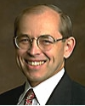
What does 2 Cor. 6:14-7:1 mean?
"
137
"The direct commands to separate from other people are always commands to separate from unbelievers, not from Christians with whom one disagrees… The are no direct New Testament commands to separate from Christians with whom one has doctrinal differences (unless those differences involve such serious heresies that the Christian faith itself is denied)."
Wayne Grudem, Systematic Theology, 877

Slide 49
Slides on
2 Corinthians 7

Slide 50
"Because we have these promises, dear friends, let us cleanse ourselves from everything that can defile our body or spirit. And let us work toward complete holiness because we fear God. ² Please open your hearts to us. We have not done wrong to anyone, nor led anyone astray, nor taken advantage of anyone" (2 Cor 7:1-2 NLT).

Slide 51
“I’m not saying this to condemn you. I said before that you are in our hearts, and we live or die together with you. ⁴I have the highest confidence in you, and I take great pride in you. You have greatly encouraged me and made me happy despite all our troubles"
(2 Cor 7:3-4 NLT).

Slide 52

We should encourage our spiritual leaders also.
Notes:
Think the best of them. (Corinth thought the worst of Paul.)
Give them new covenant latitude—not old covenant legalism.
How can we encourage our leaders?
Ask them!
Give them a break.
Tell them how they minister to you.

Slide 53
How can you be responsive to God’s heart for you?

Slide 54
Open your heart to…
your leaders
(1–7)
those in need
(8–9)
2 Corinthians
Notes:
Encourage those who lead you.
Give generously to those who aren’t financially blessed like you.

Slide 55
Corinth should respond to God’s care by giving to the Jerusalem saints
(2 Cor 8–9).

Slide 56
Slides on
2 Corinthians 8

Slide 57
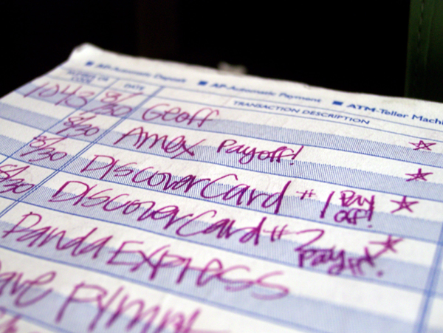
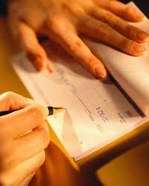
A Revealing Checkbook...
Notes:
A man married for 20 years once decided to divorce his wife. In preparing for the financial settlement, he began to rummage through his old checks.
One cancelled check after another stirred up memories of a long-forgotten past: the check to the hotel where he and his wife had spent their honeymoon, the check for their first car, the check for the hospital bill for their daughter's birth, the check for the $2000 down payment on their first home.
Finally, he could stand it no longer. He pushed the checks aside, reached for the phone, and rang up his wife. Telling her that they had invested too much in each other to throw it all away, he asked her for a new start.
Your checkbook and mine also tells the story of our lives—our values and our lifestyles. And more than anything else, our checkbook reveals our true walk with God because it announces what our treasures are (Chuck Swindoll, A Minister Everyone Would Respect, 1).

Slide 58

Ron Blue on faking...
"You can't fake stewardship. Your checkbook reveals all you really believe about stewardship…your goals, priorities, convictions, relationships, and even the use of your time. A person who has been a Christian even for a short while can fake prayer, Bible study, evangelism, going to church, and so on, but he can't fake what his checkbook reveals"
(Ron Blue, Master Your Money, 20)

Slide 59
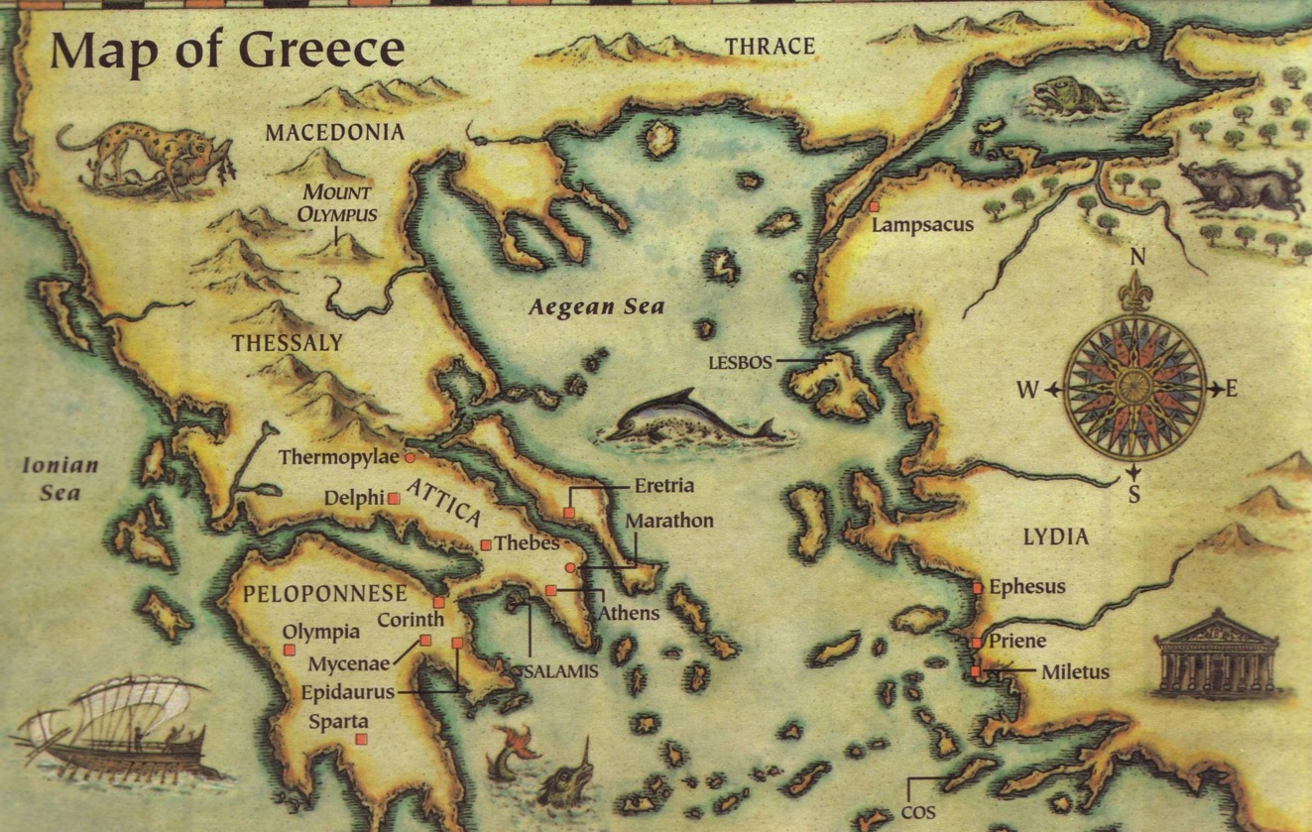
"Rich" in 2 Corinthians 8-9
Macedonia
The Macedonians showed "rich generosity" (8:2).
The Corinthians are said to be rich through Christ (8:9).
God promises that those who fulfill certain conditions "will be made rich in every way" (9:11).
Corinth
Paul redefines true wealth

Slide 60
The Macedonians gave way beyond what their means could support
(8:1-3a)
"¹And now, brothers, we want you to know about the grace that God has given the Macedonian churches. ²Out of the most severe trial, their overflowing joy and their extreme poverty welled up in rich generosity. ³For I testify that they gave as much as they were able, and even beyond their ability."

Slide 61
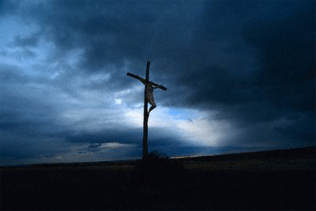
Christ also gave sacrificially by laying aside His rights as God to become human (8:8-9).
Another example of generosity...
I am not commanding you, but I want to test the sincerity of your love by comparing it with the earnestness of others. ⁹For you know the grace of our Lord Jesus Christ, that though he was rich, yet for your sakes he became poor, so that you through his poverty might become rich.

Slide 62

The Three Principles
Procrastination
Proportion
Purpose

Slide 63
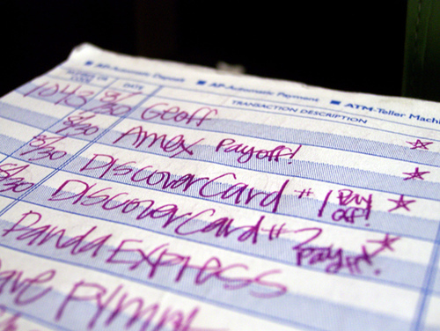
What if Jesus saw your chequebook?

Slide 64

If I knew the exact amount God wanted me to give, would I give it?

Slide 65
Slides on
2 Corinthians 9

Slide 66
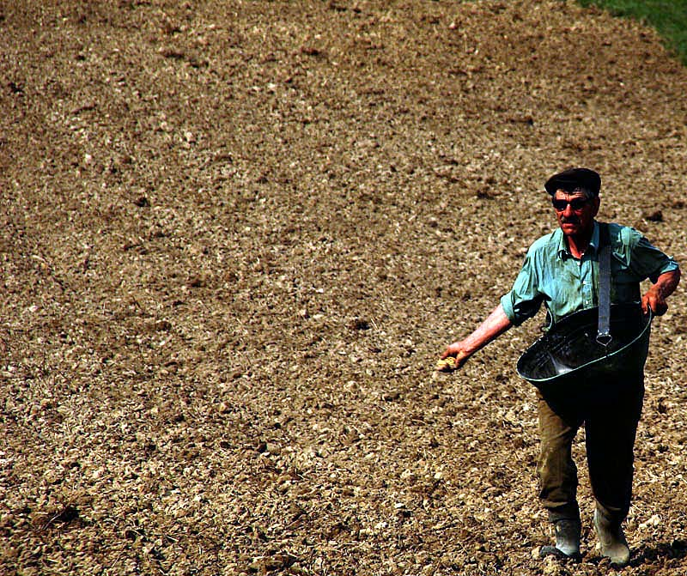
Sowing Lessons
2 Corinthians 9:6-15

Slide 67
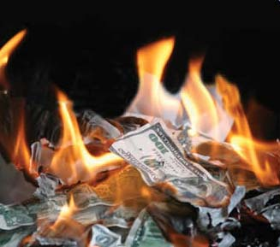
Two questions on giving:
2 Corinthians 9:6
How much?
What results?
• Key Principle
• Benefits

Slide 68
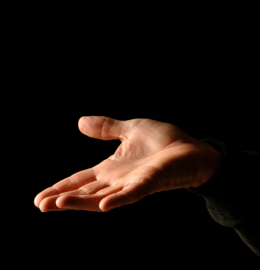
I. Principle: You decide how much you want to get blessed (9:6-7a).

Slide 69
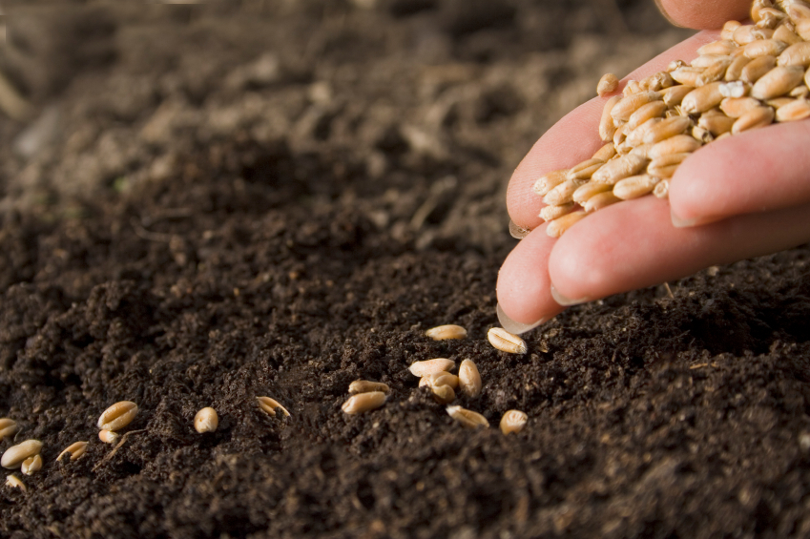
A. God blesses you according to how much you give (9:6).
⁶"Remember this—a farmer who plants only a few seeds will get a small crop. But the one who plants generously will get a generous crop" (NLT).

Slide 70
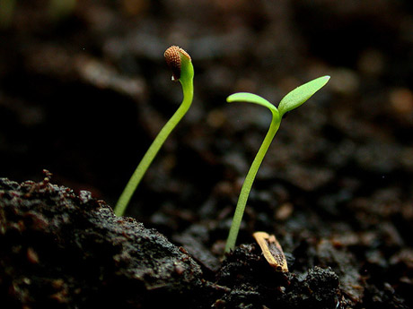
Plant little, harvest little
Plant much, harvest much
Rule #1 of Agriculture...

Slide 71
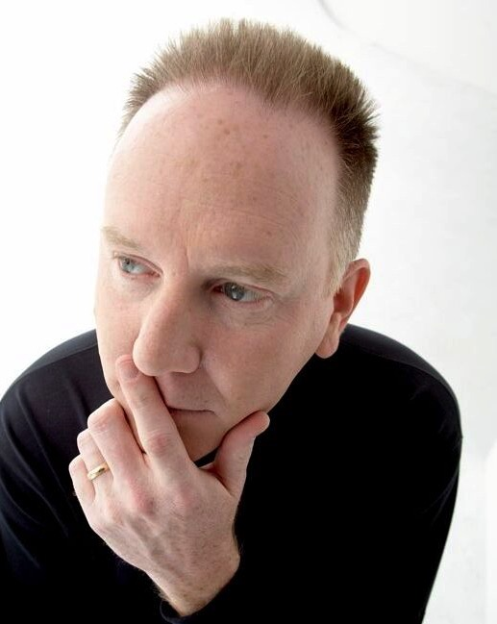

B. How much you give is a personal decision (9:7a).
⁷ You must each decide in your heart how much to give (NLT).
How much should I give?

Slide 72

II. Benefits: Generous giving yields generous returns for you, God, and others (9:7b-15).

Slide 73

Give to the Needy

Slide 74
Slides on
2 Corinthians 10

Slide 75
Open your heart to…
your leaders
(1–7)
God
(10–13)
those in need
(8–9)
2 Corinthians
Notes:
Don’t be your own boss but instead live under God’s authority.

Slide 76
Corinth should respond to God’s care by submitting to his authority
(2 Cor 10–13).

Slide 77
"Now I, Paul, appeal to you with the gentleness and kindness of Christ—though I realize you think I am timid in person and bold only when I write from far away. ²Well, I am begging you now so that when I come I won’t have to be bold with those who think we act from human motives" (2 Cor 10:1-2 NLT).

Slide 78
Slides on
2 Corinthians 11

Slide 79
Paul's Sacrifices…
2 Corinthians 11:23-28 I have worked much harder, been in prison more frequently, been flogged more severely, and been exposed to death again and again. ²⁴Five times I received from the Jews the forty lashes minus one. ²⁵Three times I was beaten with rods, once I was stoned, three times I was shipwrecked, I spent a night and a day in the open sea, ²⁶I have been constantly on the move. I have been in danger from rivers, in danger from bandits, in danger from my own

Slide 80
Paul's Sacrifices…
countrymen, in danger from Gentiles; in danger in the city, in danger in the country, in danger at sea; and in danger from false brothers. ²⁷I have labored and toiled and have often gone without sleep; I have known hunger and thirst and have often gone without food; I have been cold and naked. ²⁸Besides everything else, I face daily the pressure of my concern for all the churches.

Slide 81
Slides on
2 Corinthians 12

Slide 82

“This boasting will do no good, but I must go on. I will reluctantly tell about visions and revelations from the Lord. ²I was caught up to the third heaven fourteen years ago. Whether I was in my body or out of my body, I don’t know—only God knows. ³Yes, only God knows whether I was in my body or outside my body. But I do know ⁴that I was caught up to paradise and heard things so astounding that they cannot be expressed in words, things no human is allowed to tell”
(2 Cor 12:1-4 NLT).

Slide 83

Thorn In The Flesh
2 Cor. 12:7

Slide 84

Thorn in The Flesh
Meaning of Thorn
What does these "thorn" refer to?
i. Spiritual Harassment
ii. Persecution
iii. Physical Ailment
Lessons from Paul

Slide 85
Slides on
2 Corinthians 13
Notes:
They must submit to God’s authority by loving each other (13:11-14).

Slide 86

“May the grace of the Lord Jesus Christ, the love of God, and the fellowship of the Holy Spirit be with you all”
(2 Cor 13:14 NLT)

Slide 87

Do you offer your life to God with open hands and heart?

Slide 88
How can you be responsive to God’s heart for you?

Slide 89
Open your heart to…
your leaders
(1–7)
God
(10–13)
the needy
(8–9)
Main Idea of 2 Corinthians
Notes:
Have a heart towards those who take care of you,
towards those too weak to help you,
and to the One who cares for you the most!

Slide 90
Open your heart to…
your leaders
(1–7)
God
(10–13)
those in need
(8–9)
Which relates most to you?
Notes:
Encourage those who lead you.
Give generously to those who aren’t financially blessed like you.
Don’t be your own boss but instead live under God’s authority.

Slide 91
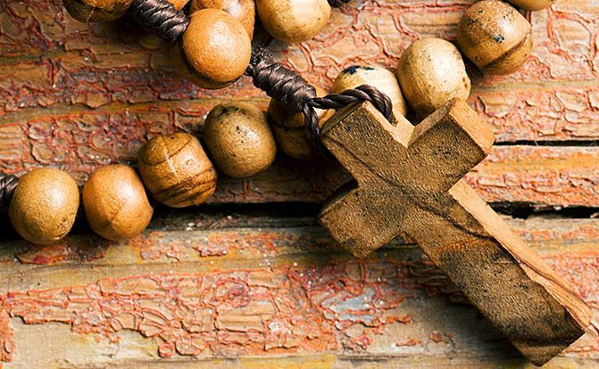
I can best open my heart to God by…
Applying 2 Corinthians
Notes:
Complete this sentence

Slide 92
Black

Slide 93


NT Preaching • BibleStudyDownloads.org
Get this presentation and script for free!

